Slide 1
Analysis of Association Between Glucose and Incident Myocardial Infarction
Zach Frere, Zhenhui Xu, Hayley Nemeth

Slide 2
Objective
Study Aims:
To describe the distribution of glucose at Period 1 and incident MI at Period 2
To test the association between glucose at Period 1 and development of MI (incident MI) at Period 2

Slide 3
Hypothesis
Primary Hypothesis:
Higher glucose at Period 1 is associated with incidence of myocardial infarction at Period 2

Slide 4
Data Cleaning
Framingham Dataset - frmgham2.csv
Exclude Period 3 data
Exclude subjects with MI in Period 1
Create two datasets - Period 1 and Period 2
Merge datasets by RANDID
Include: Period 1 Glucose, Period 2 MI, Covariates
Remove NA’s

Slide 5
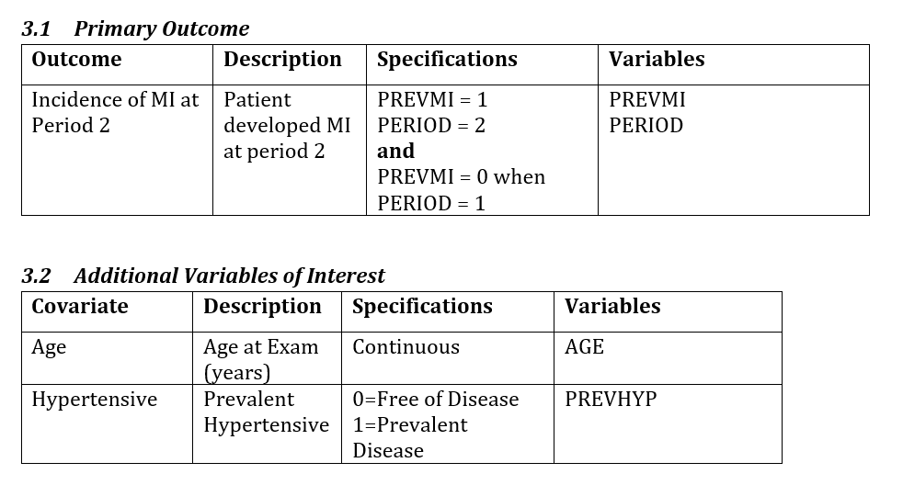
Variables

Slide 6
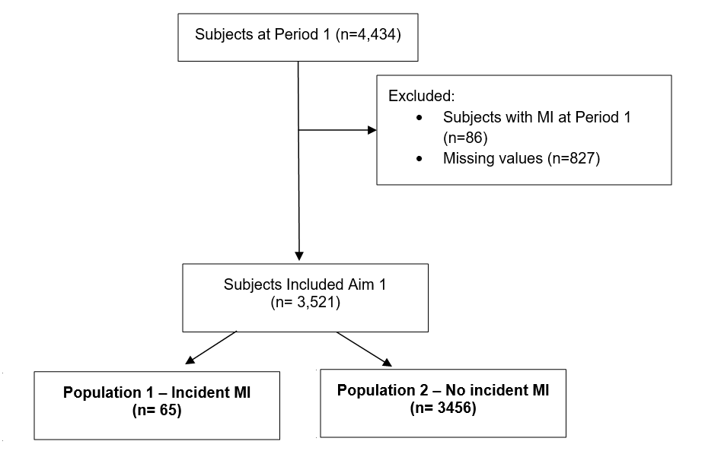
Consort Diagram

Slide 7
Statistical Analysis Plan
Initial Plan - Two sample t-test
Distributions did not appear normal
Mann-Whitney Test
Test for a difference in glucose between those with and without MI
Logistic Regression
Control for risk factors - age and hypertension

Slide 8
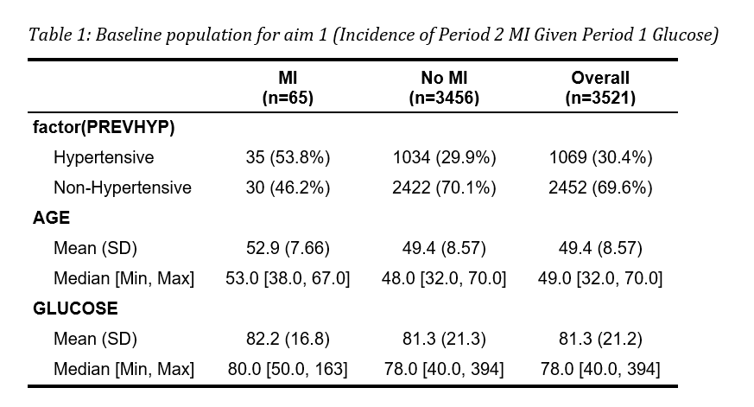
Table 1

Slide 9
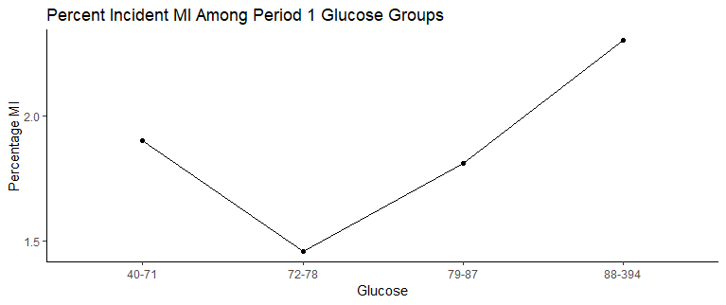
Distribution
*For reference, a Glucose value of >140 is considered abnormal and a value >200 indicates diabetes

Slide 10
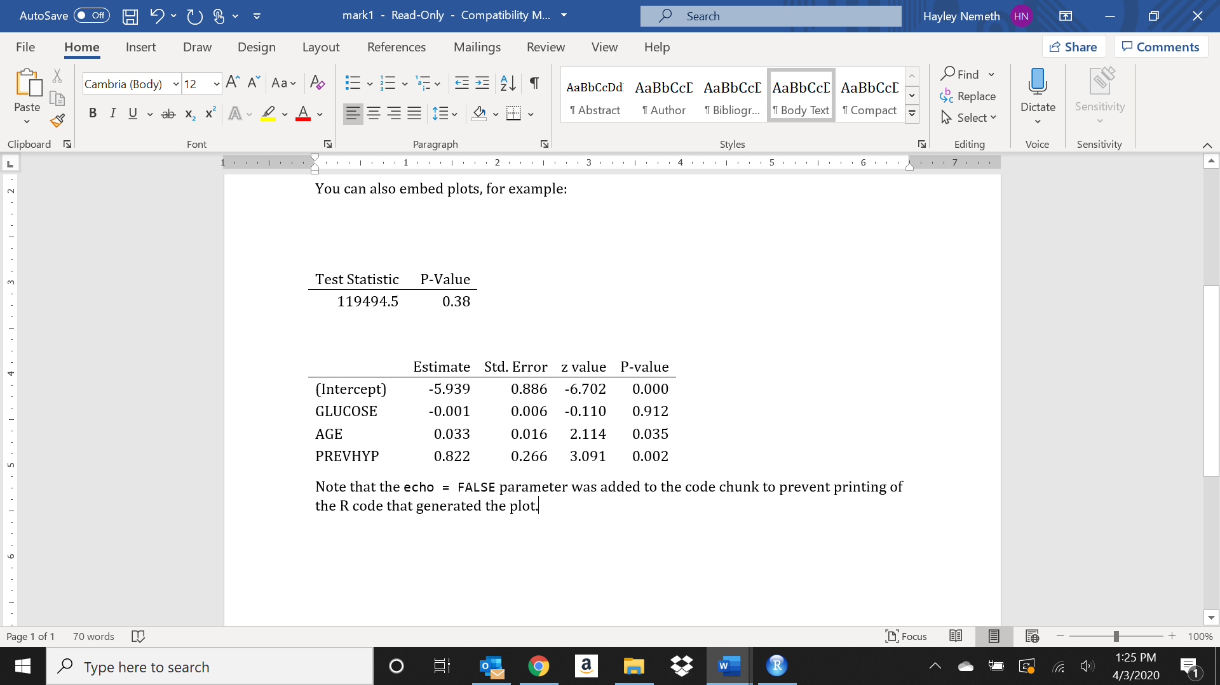
Statistical Analysis Results
Mann-Whitney Test
Logistic Regression

Slide 11
Discussion
Our analysis indicates insufficient evidence to support the hypothesis that higher glucose is associated with incident myocardial infarction.
The Mann Whitney test indicated no difference in glucose for those with MI and those without MI
The logistic regression model indicated glucose is not a significant predictor after adjusting for risk factors

